Slide 1
Storytelling for data Insights
Using Superstore Data

Slide 2
Overview of data

Slide 3
Highlight information
Contain 9994 row and 13 features
Numeric features (Sales – profit – discount )
From 2014 to 2017
Belong to US and its states

Slide 4
Analyze Sales performance

Slide 5
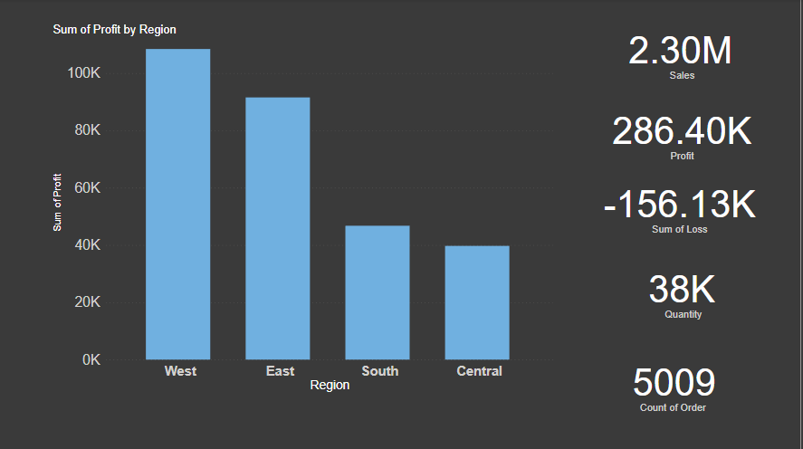

Slide 6
Insights
Total sales Around 2.3M
Most sales in West and East
If we look into the data region-wise, we can conclude that the south and central regions needs more improvement compared to others
Total loss reach more than half of profit (57%)

Slide 7
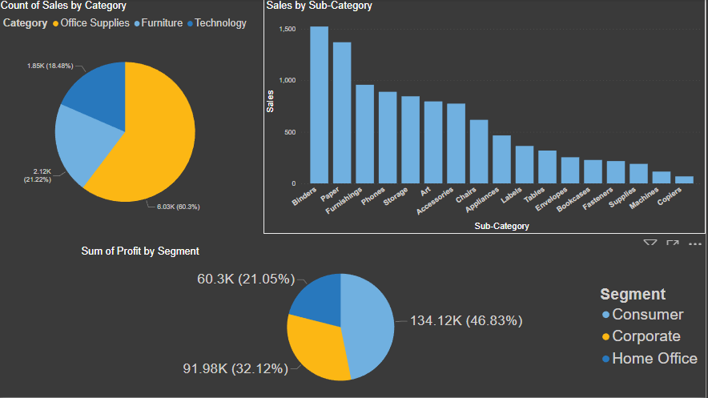

Slide 8
Insights
Most sales from office suppler then furniture then technology categories
From the above data, it’s very much clear that the Copiers and Machines Subcategory needs improvement
In the Home Office Segment, we observe that the count is less. So convergent strategy and improvement is a necessity for this Segment

Slide 9
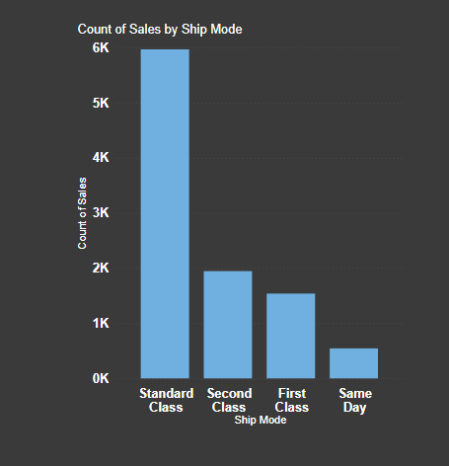
Here we observe that the sales are high if the ship mode is standard class, and sales are low if the ship mode is either First class or same day.

Slide 10
Analyze Loss states

Slide 11
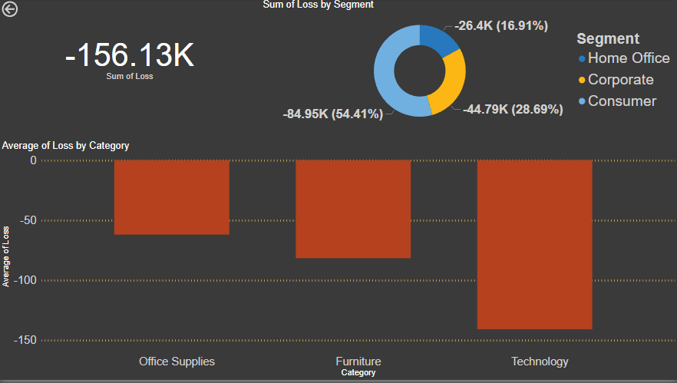

Slide 12
Total loss around 156K , need to decrease this number
While calculating an average, we observed that more loss is in the technology category
Most of loss come from Consumer segment , so need to change strategy to increase sales and decrease loss for segments

Slide 13
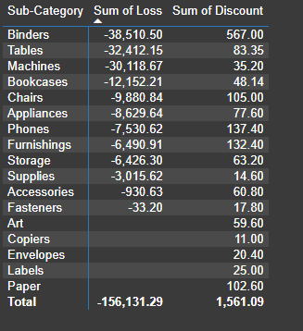

Slide 14
We can observe more loss in the Binders category, tables category, and machines category when compared to other categories.
Binders are more getting sold. So even giving less discount may lead to vast loss.
So better to give discounts on which are getting less sold so that even they will start getting sold more.
More discount leads to more loss, so, to make more profit provide fewer discounts

Slide 15
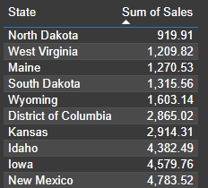
These are the last 10 states where sales are very less.

Slide 16
Overall Analysis

Slide 17

The main reason which leads to loss is Discount as if some areas lead to loss due to more discounts, and some areas lead to fewer sales due to fewer discounts, hence it needs to be improved.
It is better to give more discounts during festival seasons, additionally, that will result in more sales.
The Home office segment needs better improvement.
Some cities have fewer sales, lack of awareness can be the reason for this, hence advertising in those cities might help in more sales.

